Slide 1





WEB BASED E-WASTE AND BATTERY LIFECYCLE MANAGEMENT SYSTEM
SCHOOL OF ELECTRONICS, ELECTRICAL AND BIOMEDICAL TECHNOLOGY DEPARTMENT OF BIOMEDICAL ENGINEERING
TEAM NUMBER:06
M.Mirudhula daisy-9923005207
S.Siva Priya -9923005224
S.Deepa dharshini -9923005245
R.Siddarth -9923005265
Akuleti Bunny -99230040004
Guided By Mrs.S.Shanmugapriya Assistant Professor Department of Biomedical Engineering

Slide 2
Problem Statement
Rapid increase in electronic devices leads to high e-waste generation
Battery degradation causes unexpected device failures and performance issues
Maintenance records are manual and unorganized
No centralized system to track device health and lifecycle
Delayed detection of battery issues increases maintenance cost
Improper disposal of batteries causes environmental pollution
SCHOOL OF ELECTRONICS, ELECTRICAL AND BIOMEDICAL TECHNOLOGY DEPARTMENT OF BIOMEDICAL ENGINEERING 215BME4265 – Capstone Project

Slide 3
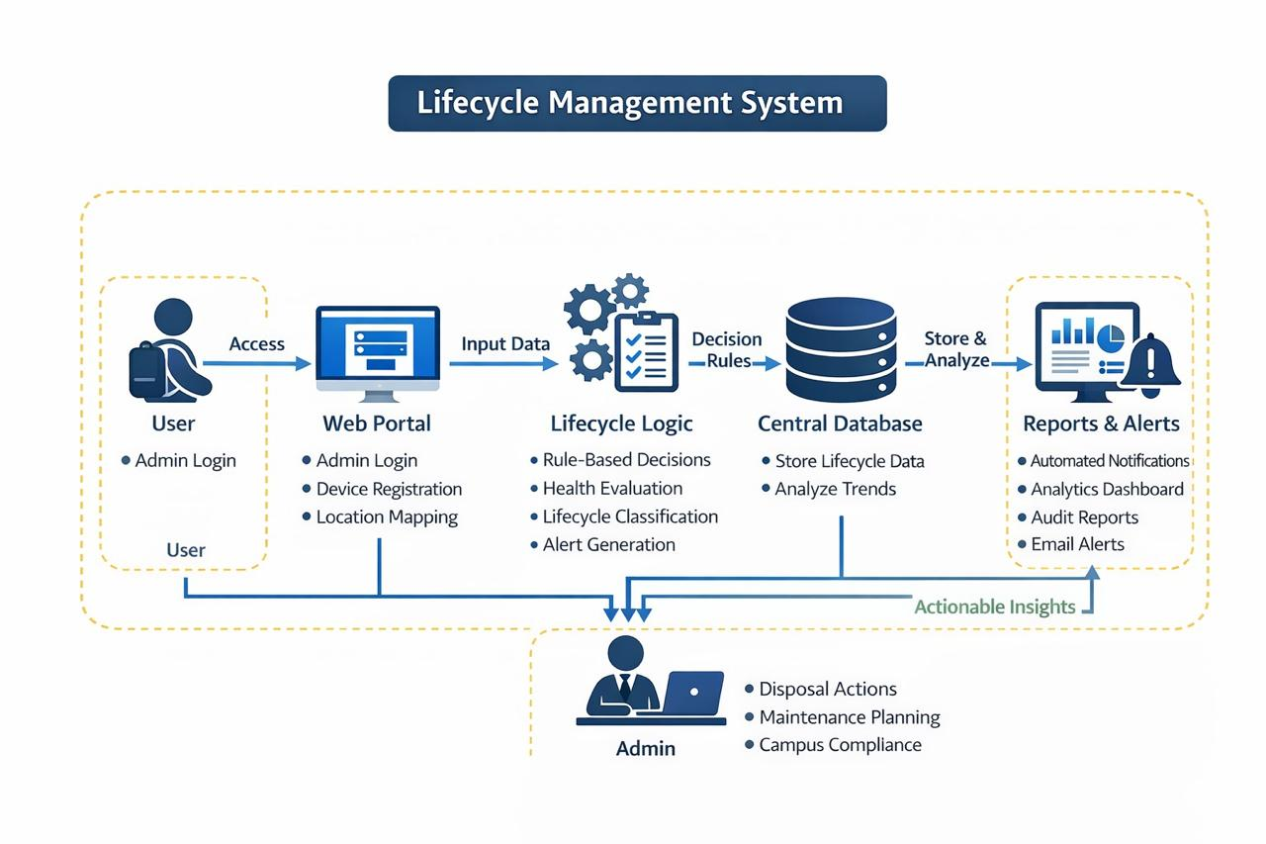
Transformation of Conventional System into Smart E-Waste & Battery Management System
SCHOOL OF ELECTRONICS, ELECTRICAL AND BIOMEDICAL TECHNOLOGY DEPARTMENT OF BIOMEDICAL ENGINEERING 215BME4265 – Capstone Project

Slide 4
Abstract
The rapid growth of electronic devices has led to a significant increase in e-waste generation, especially in institutions. Battery degradation in devices affects performance and reliability, often causing unexpected failures. Existing systems mainly rely on manual maintenance records, which are inefficient and difficult to manage. To address these issues, a web-based e-waste and battery lifecycle management system is proposed. The system enables centralized device tracking, battery health evaluation, and automated alert generation. It also provides dashboard-based analytics for effective monitoring and decision-making. Overall, the system improves maintenance efficiency and supports sustainable e-waste disposal practices.
SCHOOL OF ELECTRONICS, ELECTRICAL AND BIOMEDICAL TECHNOLOGY DEPARTMENT OF BIOMEDICAL ENGINEERING 215BME4265 – Capstone Project

Slide 5
Introduction
In recent years, the rapid growth of electronic devices in educational institutions and organizations has significantly increased the generation of electronic waste. Devices such as computers, printers, UPS systems, and networking equipment are widely used, and their batteries degrade over time due to continuous usage and environmental factors. This degradation can lead to unexpected failures, reduced performance, and increased maintenance costs. Currently, many institutions rely on manual methods to track device condition and maintenance records, which are inefficient and difficult to manage. In addition, improper disposal of batteries and electronic devices poses serious environmental risks. Therefore, there is a need for a smart and centralized system to monitor device health, manage battery lifecycle, and promote sustainable e-waste management practices.
SCHOOL OF ELECTRONICS, ELECTRICAL AND BIOMEDICAL TECHNOLOGY DEPARTMENT OF BIOMEDICAL ENGINEERING 215BME4265 – Capstone Project

Slide 6
Objectives
To develop a web-based centralized system for managing electronic devices
To monitor battery health and performance of devices
To provide early detection of battery degradation
To generate automated alerts for maintenance and replacement
To maintain lifecycle records of devices and batteries
To enable analytics and reporting for better decision-making
To promote sustainable e-waste management practices
SCHOOL OF ELECTRONICS, ELECTRICAL AND BIOMEDICAL TECHNOLOGY DEPARTMENT OF BIOMEDICAL ENGINEERING 215BME4265 – Capstone Project

Slide 7
Motivation & Significance
The rapid growth of electronic devices has significantly increased e-waste, creating challenges in proper management and disposal. Many institutions lack efficient monitoring systems, leading to frequent device failures and high maintenance costs. Manual tracking of device and battery conditions is time-consuming and inefficient. Improper battery disposal also causes environmental risks. This project offers a smart, centralized solution for effective device and battery management, enhancing reliability while supporting sustainable practices and better resource utilization.
SCHOOL OF ELECTRONICS, ELECTRICAL AND BIOMEDICAL TECHNOLOGY DEPARTMENT OF BIOMEDICAL ENGINEERING 215BME4265 – Capstone Project

Slide 8
Motivation & Significance (Cont..)
IEEE 12207 for software life cycle
IEEE 830 / 29148 for requirements
IEEE 802.11 for communication
Low cost system
Manual data entry dependency
Need for accurate data
Fast alert generation
Efficient data handling
SCHOOL OF ELECTRONICS, ELECTRICAL AND BIOMEDICAL TECHNOLOGY DEPARTMENT OF BIOMEDICAL ENGINEERING 215BME4265 – Capstone Project

Slide 9
Literature Review
S. No | Title | Published Year | Observation | Methodology
1 | Web-Based Electronic Waste Management System | 2018 | Improved e-waste data organization and recycling efficiency but lacked battery monitoring features | Developed a web-based platform for centralized e-waste data handling
2 | E-Waste Tracker System | 2019 | Enhanced transparency in waste collection and disposal but limited device-level tracking | Tracking system from collection to recycling using database systems
3 | IoT-Based E-Waste Monitoring System | 20210 | Provided real-time monitoring but increased system complexity and cost | IoT sensors used for monitoring waste levels and system status
4 | Cloud-Based E-Waste Data Management Platform | 2020 | Enabled scalable data access but lacked predictive maintenance features | Cloud storage and centralized data access for distributed systems
5 | Battery Health Monitoring System | 2021 | Focused on battery parameters but lacked integration with e-waste management | Rule-based evaluation using voltage, temperature, and charge cycles
SCHOOL OF ELECTRONICS, ELECTRICAL AND BIOMEDICAL TECHNOLOGY DEPARTMENT OF BIOMEDICAL ENGINEERING 215BME4265 – Capstone Project

Slide 10
Literature Review (Cont..)
S. No | Title | Published Year | Observation | Methodology
6 | Predictive Maintenance using Machine Learning | 2021 | Improved failure prediction but required large datasets and computational resources | Machine learning models used for predicting device failures
7 | Lifecycle Management of Electronic Devices | 2022 | Highlighted importance of lifecycle tracking but lacked real-time alerts | Usage-based lifecycle estimation and replacement planning
8 | Review on E-Waste Management Systems | 2022 | Identified need for integrated systems combining monitoring and analytics | Analysis of multiple e-waste management approaches
9 | Data-Driven E-Waste Analysis System | 2023 | Provided trend analysis but limited real-time monitoring capability | Data analytics used for studying e-waste generation patterns
10 | Smart Integrated E-Waste Management Platform | 2022 | Combined multiple technologies but increased system complexity | Integration of IoT, AI, and analytics for smart waste management
SCHOOL OF ELECTRONICS, ELECTRICAL AND BIOMEDICAL TECHNOLOGY DEPARTMENT OF BIOMEDICAL ENGINEERING 215BME4265 – Capstone Project

Slide 11
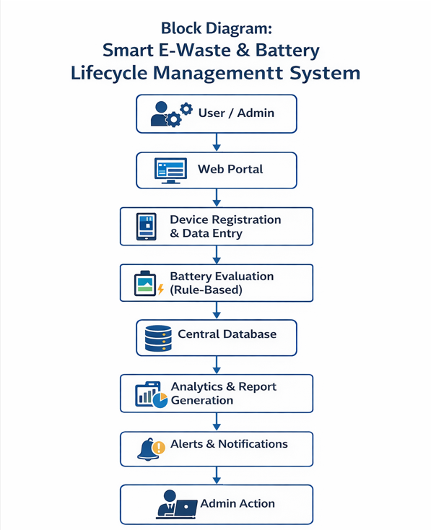
Block Diagram / Architecture
SCHOOL OF ELECTRONICS, ELECTRICAL AND BIOMEDICAL TECHNOLOGY DEPARTMENT OF BIOMEDICAL ENGINEERING 215BME4265 – Capstone Project

Slide 12
Proposed Work
Develop a web-based e-waste and battery management system
Monitor battery parameters using rule-based evaluation
Register and track electronic devices centrally
Generate alerts for maintenance and replacement
Maintain lifecycle records of devices
Provide analytics dashboard for monitoring and decision-making
Support sustainable e-waste management practices
SCHOOL OF ELECTRONICS, ELECTRICAL AND BIOMEDICAL TECHNOLOGY DEPARTMENT OF BIOMEDICAL ENGINEERING 215BME4265 – Capstone Project

Slide 13
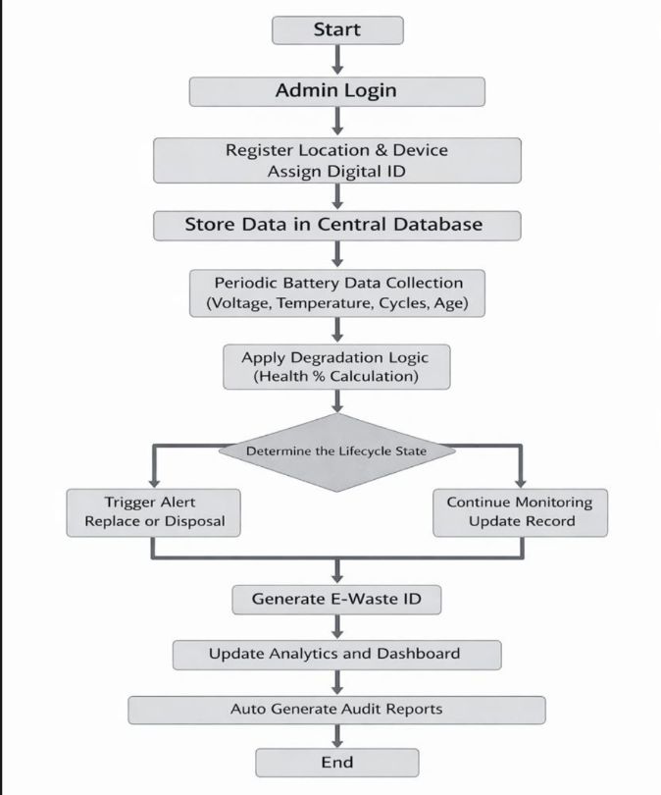
Flow chart
SCHOOL OF ELECTRONICS, ELECTRICAL AND BIOMEDICAL TECHNOLOGY DEPARTMENT OF BIOMEDICAL ENGINEERING 215BME4265 – Capstone Project

Slide 14
Design and Implementation
The proposed system is a web-based software solution designed using a modular architecture. It is developed using standard frontend and backend technologies with a centralized database to store device and lifecycle information. The system includes modules for device registration, maintenance data entry, battery condition evaluation, alert generation, and analytics. A rule-based approach is used to assess battery health based on input parameters. The dashboard provides visual reports for monitoring device performance and e-waste trends. The overall design ensures scalability, efficient data management, and a user-friendly interface for easy operation.
SCHOOL OF ELECTRONICS, ELECTRICAL AND BIOMEDICAL TECHNOLOGY DEPARTMENT OF BIOMEDICAL ENGINEERING 215BME4265 – Capstone Project

Slide 15
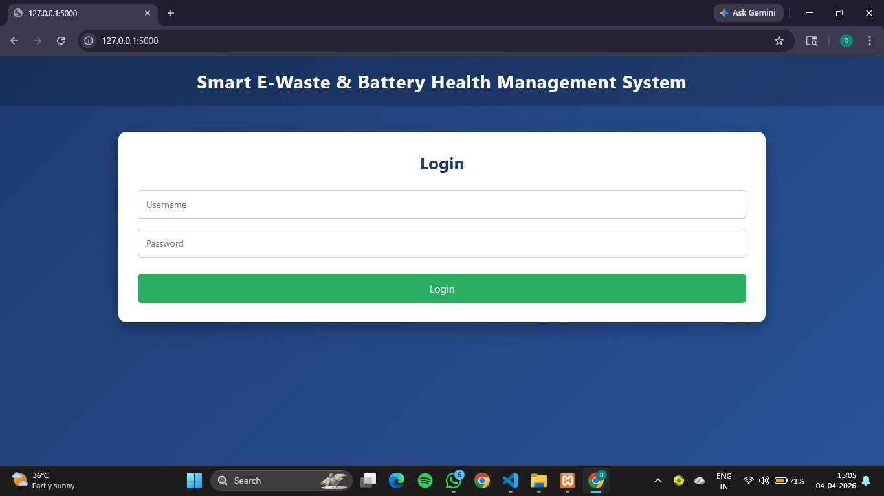
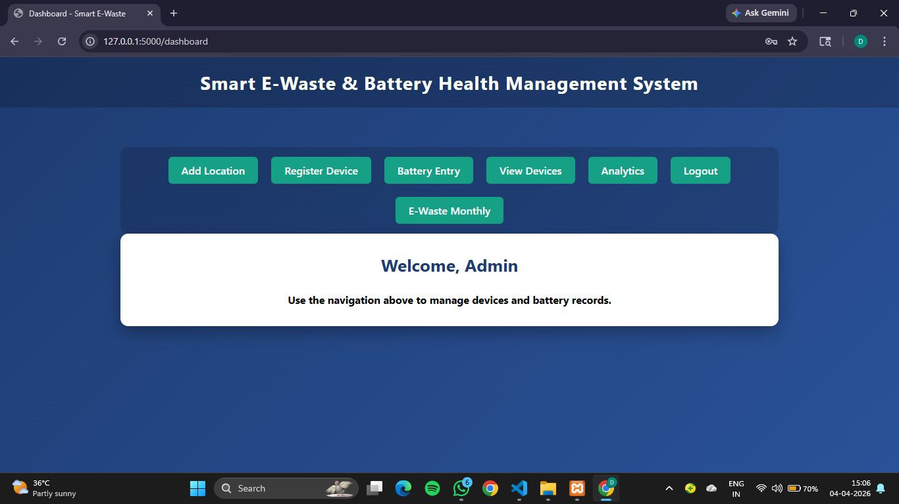
Software Design(Cont..)
SCHOOL OF ELECTRONICS, ELECTRICAL AND BIOMEDICAL TECHNOLOGY DEPARTMENT OF BIOMEDICAL ENGINEERING 215BME4265 – Capstone Project

Slide 16
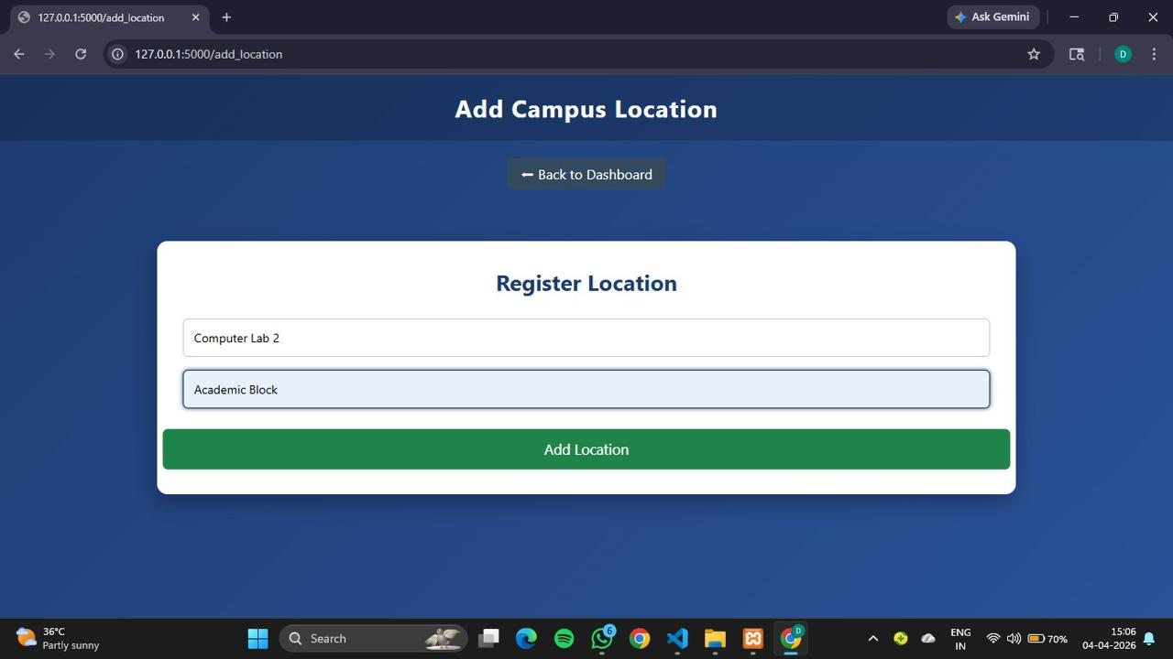
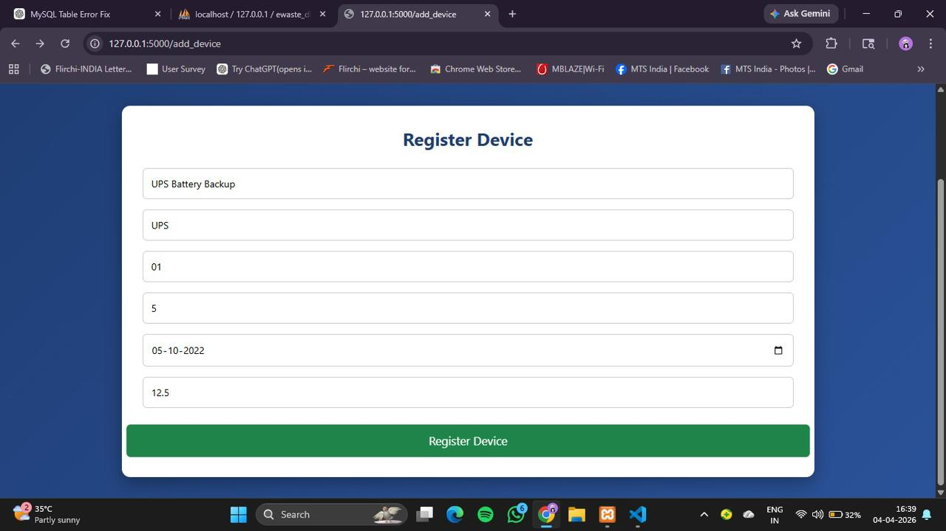
Software Design (Cont..)

Slide 17
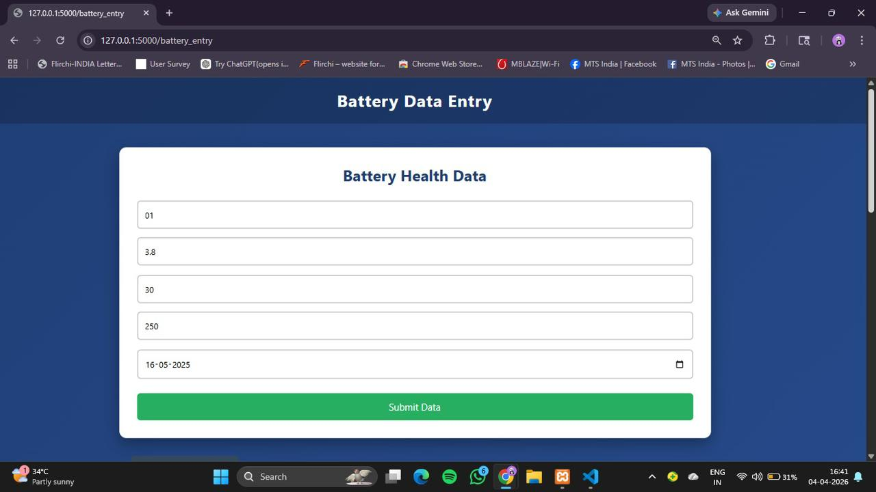
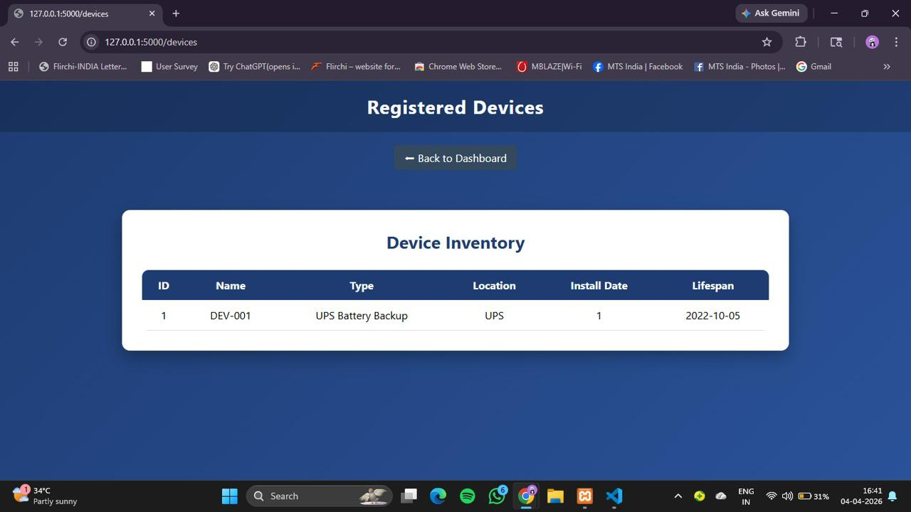
Software Design (Cont..)
SCHOOL OF ELECTRONICS, ELECTRICAL AND BIOMEDICAL TECHNOLOGY DEPARTMENT OF BIOMEDICAL ENGINEERING 215BME4265 – Capstone Project

Slide 18
Comparison with Existing Method
Feature | Existing Method (Manual System) | Proposed System
Device tracking | Manual records | Centralized web-based tracking
Battery monitoring | No | Yes
Maintenance alerts | No | Yes
Data management | Paper/Excel based | Central database
Lifecycle tracking | No | Yes
Analytics & reports | No | Yes
E-waste management | Limited | Efficient & structured
SCHOOL OF ELECTRONICS, ELECTRICAL AND BIOMEDICAL TECHNOLOGY DEPARTMENT OF BIOMEDICAL ENGINEERING 215BME4265 – Capstone Project

Slide 19
Conclusion
The proposed web-based e-waste and battery lifecycle management system provides an efficient solution for monitoring electronic devices and managing battery health. It overcomes the limitations of manual maintenance systems by offering centralized tracking, rule-based evaluation, and automated alert generation. The system improves maintenance planning, reduces unexpected failures, and enhances overall device reliability. In addition, the analytics dashboard supports better decision-making and promotes sustainable e-waste management practices. Overall, the system contributes to improved operational efficiency and environmental responsibility.
SCHOOL OF ELECTRONICS, ELECTRICAL AND BIOMEDICAL TECHNOLOGY DEPARTMENT OF BIOMEDICAL ENGINEERING 215BME4265 – Capstone Project

Slide 20
Future Work
The proposed system can be further enhanced by integrating IoT sensors to enable automatic collection of battery parameters such as voltage, temperature, and charge cycles, reducing dependency on manual data entry. Machine learning techniques can be applied to predict battery failures at an early stage using historical data. The system can also be deployed on the cloud to support monitoring across multiple locations and improve scalability. In addition, advanced analytics can provide deeper insights for better decision-making. Future improvements may include smart classification of e-waste for reuse, recycling, or safe disposal, along with mobile application support for easier access and management.
SCHOOL OF ELECTRONICS, ELECTRICAL AND BIOMEDICAL TECHNOLOGY DEPARTMENT OF BIOMEDICAL ENGINEERING 215BME4265 – Capstone Project

Slide 21
References
[1] REFERENCE F. N. A. Shiby and S. Samatitha Wijegoda, “Development of a web-based electronic waste management: A study with special reference to recycling companies in Sri Lanka,” International Journal of Engineering Research and Technology, vol. 7, no. 4, pp. 1–6, 2018.
[2] S. Armstrong, A. Ghasemlou, and I. A. Hamed, “E waste tracker: A platform to monitor e-waste from collection to recycling,” International Journal of Environmental Science and Technology, vol. 16, no. 2, pp. 1–8, 2019.
[3] S. T. Pr. Suma, “E-waste management system,” International Journal of Engineering and Technology, vol. 8, no. 4, pp. 210–215, 2021.
SCHOOL OF ELECTRONICS, ELECTRICAL AND BIOMEDICAL TECHNOLOGY DEPARTMENT OF BIOMEDICAL ENGINEERING 215BME4265 – Capstone Project

Slide 22
References (Cont..)
[4] S. R. Spoorthi, “Web-based waste management system,” International Journal of Computer Science and Information Technology, vol. 9, no. 1, pp. 30–35, 2021.
[5] A. Kumar et al., “IoT-based smart e-waste management system,” International Journal of Smart Technology, 2020. [
[6] P. Ravi et al., “Electronic device maintenance monitoring system,” IEEE Access, 2021.
[7] D. Patel et al., “Cloud-based e-waste data management platform,” Journal of Environmental Informatics, 2020..

Slide 23
References (Cont..)
[8] R. Singh et al., “Battery health monitoring using rule based systems,” International Journal of Energy Research, 2021.
[9] M. Rahman et al., “Lifecycle management of electronic devices,” Sustainable Computing, 2022.
[10] L. Chen et al., “Data-driven analysis of e-waste generation,” Waste Management Journal, 2021.
[11] Y. Li et al., “IoT-based UPS battery monitoring system,” IEEE Sensors Journal, 2020.
[12] H. Zhang et al., “Predictive maintenance using machine learning,” IEEE Transactions on Industrial Informatics, 2021.

Slide 24
References (Cont..)
[14] V. Verma et al., “Automated battery alert system,” Energy Systems Journal, 2021.
[15] J. Joseph et al., “Integrated e-waste management platform,” Environmental Systems Research, 2022.
[16] K. Nair et al., “Dashboard-based device monitoring system,” IEEE Conference Proceedings, 2021.
[17] R. Gupta et al., “Centralized database for device management,” Journal of Information Systems, 2020.
[18] T. Hassan et al., “Embedded battery monitoring system,” Microelectronics Journal, 2021. [19] S. Roy et al., “Statistical battery failure prediction,” Energy Reports, 2022
[19] S. Roy et al., “Statistical battery failure prediction,” Energy Reports, 2022.
SCHOOL OF ELECTRONICS, ELECTRICAL AND BIOMEDICAL TECHNOLOGY DEPARTMENT OF BIOMEDICAL ENGINEERING 215BME4265 – Capstone Project

Slide 25
References (Cont..)
[20] P. Das et al., “Lightweight monitoring system for institutions,” International Journal of Engineering Trends, 2021.
[21] A. Mehta et al., “Cloud-integrated monitoring platform,” IEEE Cloud Computing, 2022.
[22] F. Khan et al., “Alert-based maintenance system,” International Journal of Advanced Computing, 2021.
[23] R. Iyer et al., “Hybrid e-waste and device monitoring system,” Sustainable Technology Journal, 2022.
[24] N. Sharma et al., “Analytics-driven e-waste tracking system,” Journal of Cleaner Production, 2023.
.
SCHOOL OF ELECTRONICS, ELECTRICAL AND BIOMEDICAL TECHNOLOGY DEPARTMENT OF BIOMEDICAL ENGINEERING 215BME4265 – Capstone Project

Slide 26
References (Cont..)
[25] Proposed Work, “Smart E-Waste Monitoring and Battery Lifecycle Management System,” 2026

Slide 27


SCHOOL OF ELECTRONICS, ELECTRICAL AND BIOMEDICAL TECHNOLOGY DEPARTMENT OF BIOMEDICAL ENGINEERING 215BME4265 – Capstone Project

